Slide 1
HSC 509 Perspectives on Human Behaviour
Monsoon Semester 2022-23
Department of Humanities and Social Sciences
Indian Institute of Technology (ISM) Dhanbad

Slide 2
Issues in Psychology
Scientific inquiry is to be Objective and Value-free
Findings must be Universal
If Psychology is a science, then it must have these 3 characteristics

Slide 3
Issues in Psychology
Claim to being objective (or unbiased) has come under sever criticism
Two of the most dominant ones are:
Sexism
Ethnocentrism

Slide 4
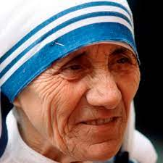
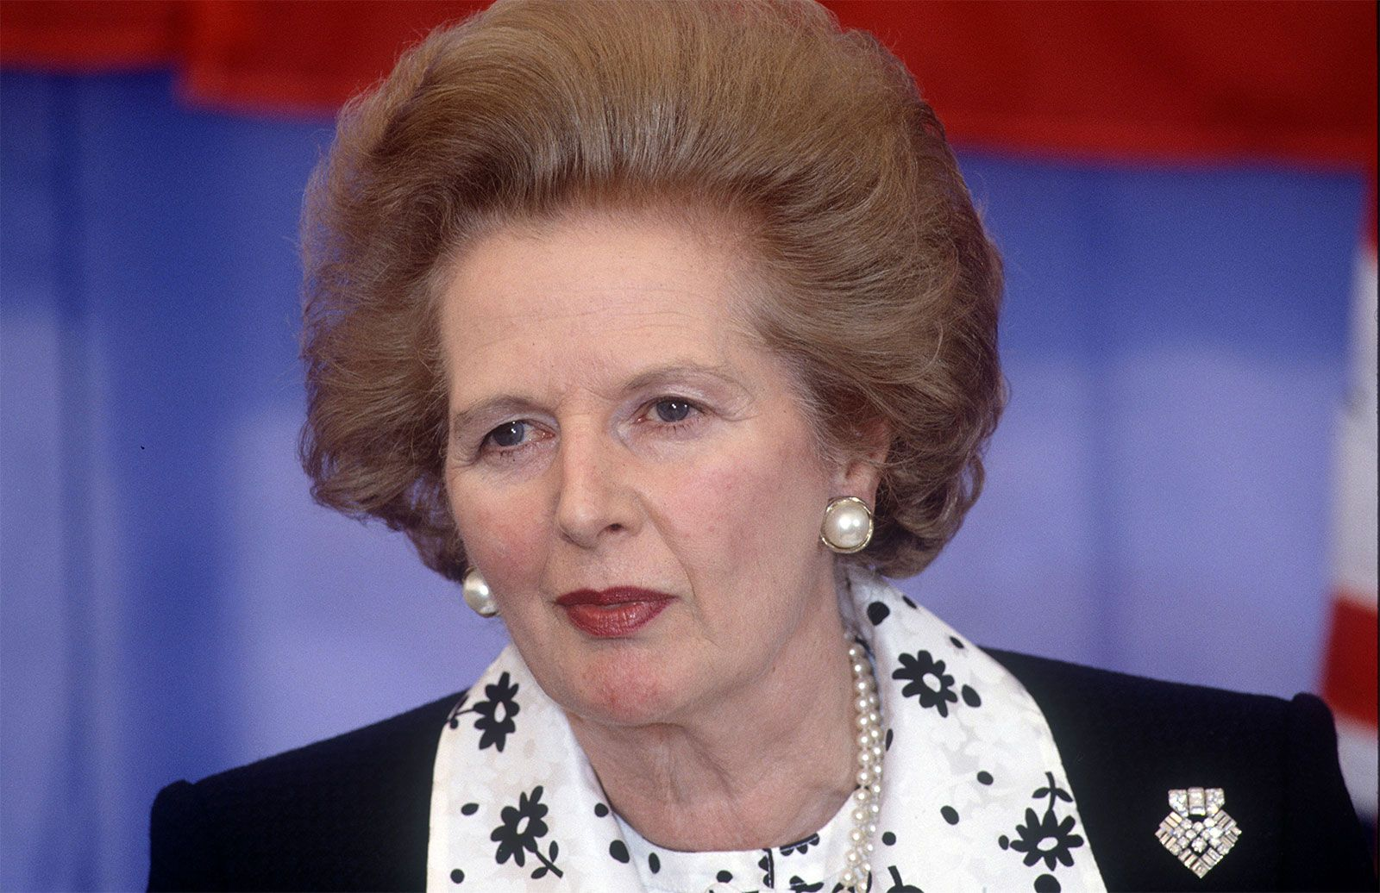
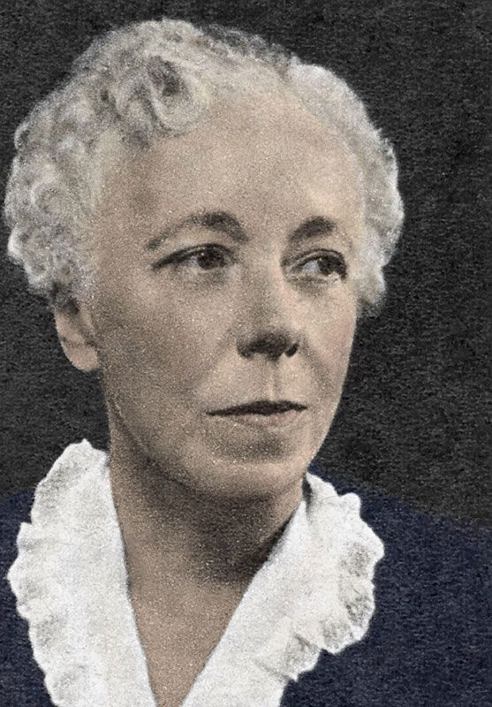
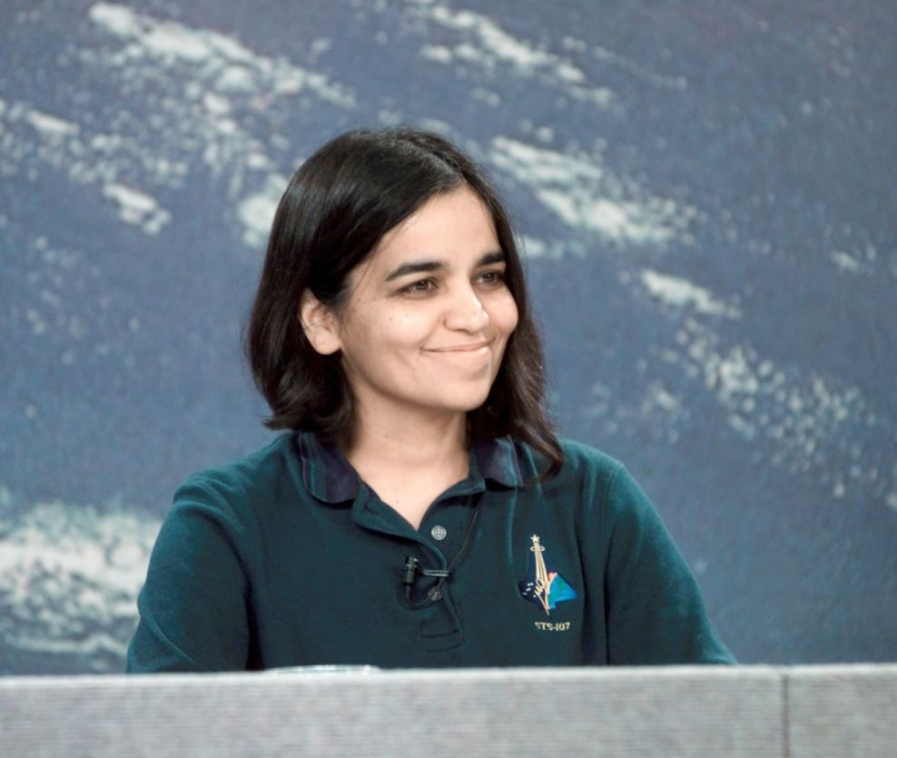

Slide 5
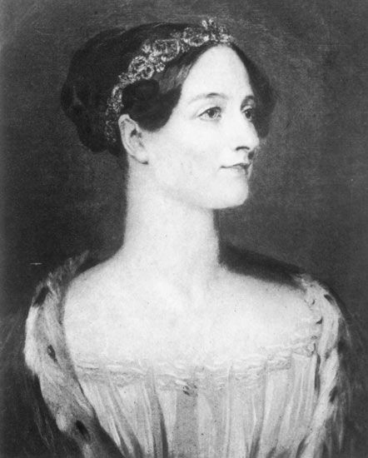
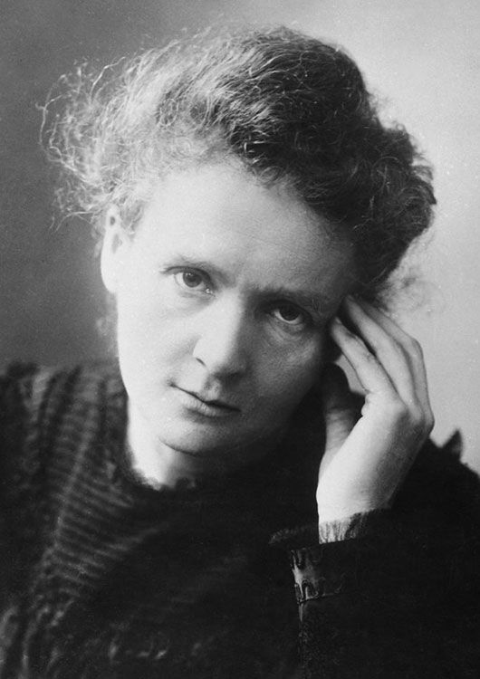
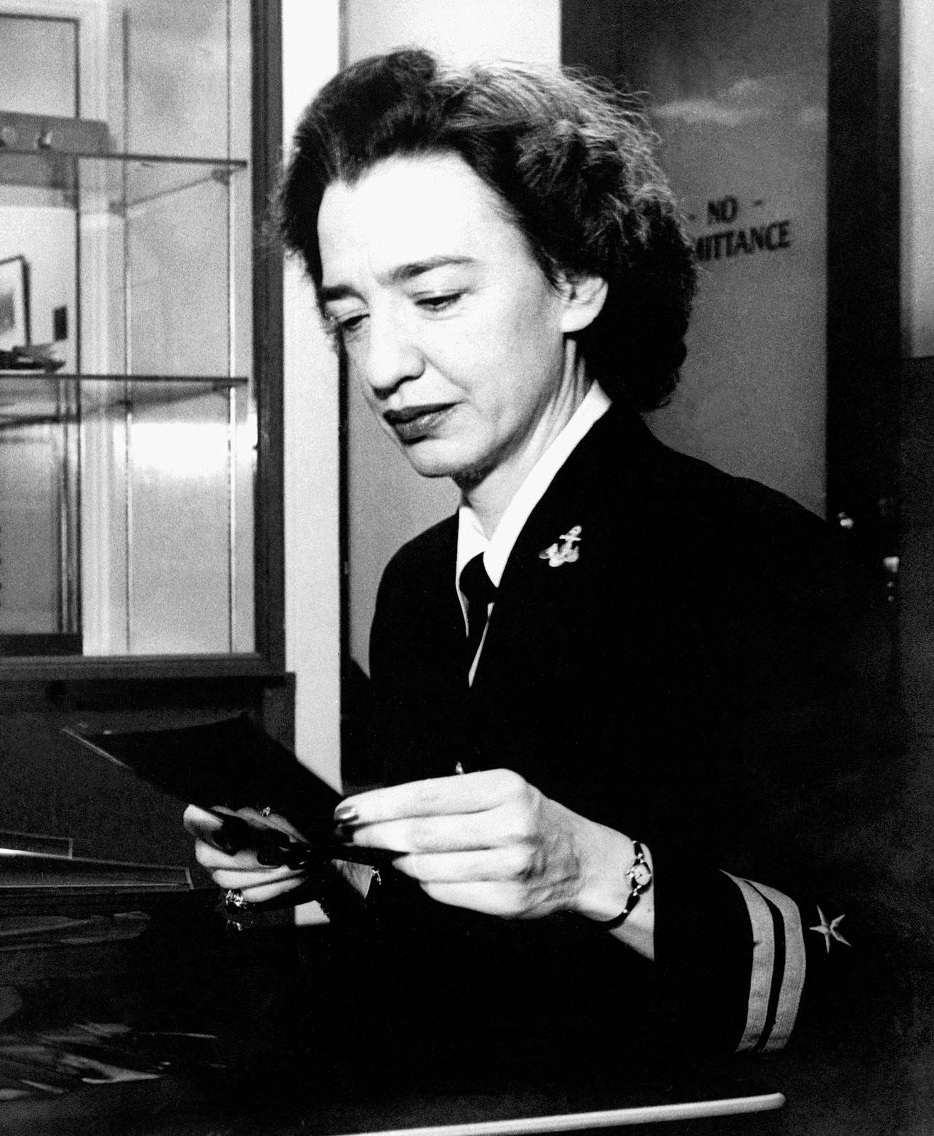

Slide 6
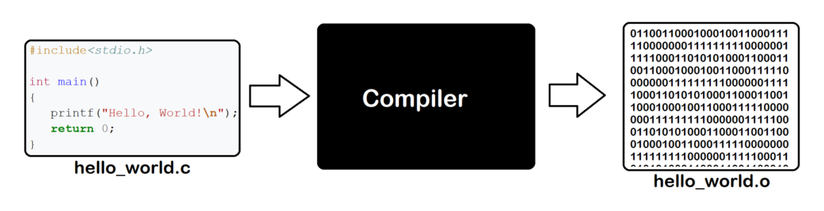
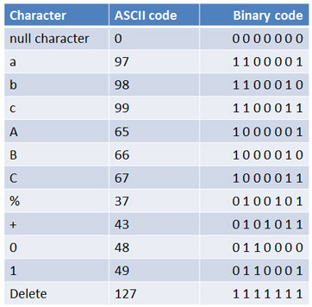

Slide 7
Text | Binary Code
sameer | 01110011 01100001 01101101 01100101 01100101 01110010
gender bias | 01100111 01100101 01101110 01100100 01100101 01110010 00100000 01100010 01101001 01100001 01110011
Hsc 509 perspectives on human behaviour | 01101000 01110011 01100011 00100000 00110101 00110000 00111001 00100000 01110000 01100101 01110010 01110011 01110000 01100101 01100011 01110100 01101001 01110110 01100101 01110011 00100000 01101111 01101110 00100000 01101000 01110101 01101101 01100001 01101110 00100000 01100010 01100101 01101000 01100001 01110110 01101001 01101111 01110101 01110010

Slide 8
Gender Bias
Feminist Psychology
Bias: Distorted view of reality / world
Gender Bias: A view that is inconsistent with the experience of men or women or both (usually women)

Slide 9

Gender Bias: The Dynamics
Androcentrism: Male centered-ness i.e. Male perspective is the most important viewpoint.
Alpha Bias: Gender difference is exaggerated.
Freud: feminity is a form of failed masculinity
Evolutionary explanation of male promiscuity

Slide 10
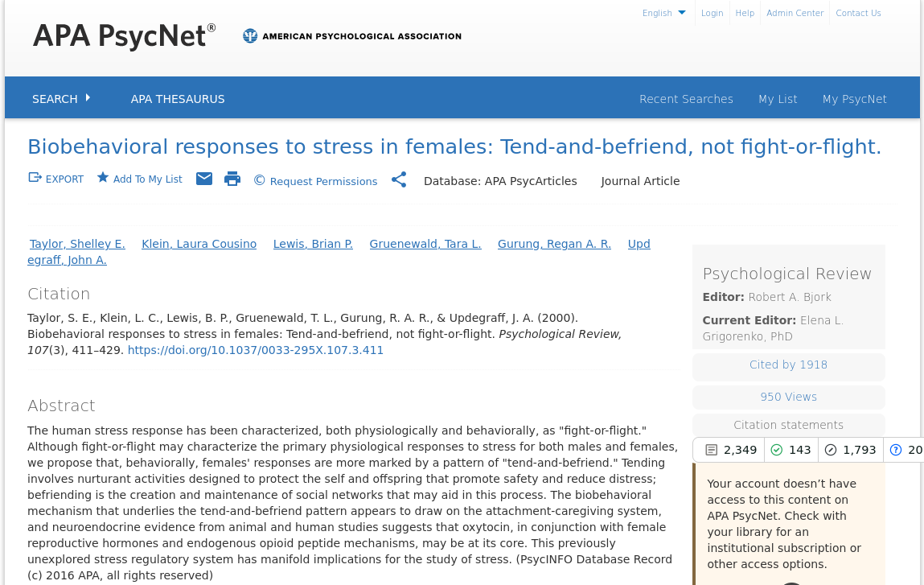
Gender Bias: The Dynamics
Androcentrism: Male centered-ness i.e. Male perspective is the most important viewpoint.
Beta Bias: Sex differences are minimized or ignored.
Differential treatment of males and females by male experimenters
Fight-or-flight vs Tend-and-Befriend

Slide 11
Gender Bias: The Genuine Differences
Verbal Ability: Girls
Aggression: Boys
Visuo-spatial abilities: Boys
Arithmetic: Boys
Coping Strategies:
Problem focused: Boys
Emotion focused: Girls

